Slide 1
Introduction to Deep Learning & its Libraries

Slide 2

Deep Learning in AI.
Artificial Intelligence
Machine Learning
Deep Learning

Slide 3
Deep Learning.
Recognition
Brain
Vision
Training
Dataset
Model
Recognition

Slide 4
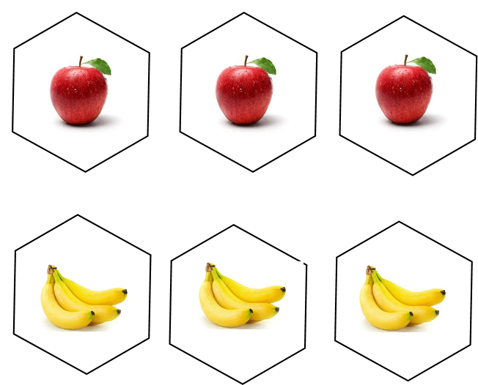
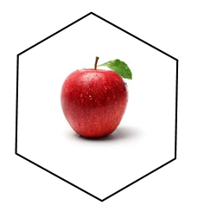
Why Deep Learning ?
Prediction
AI
Automatic Feature Extraction
Input Data
It’s an apple

Slide 5
Why GPU ?
“It Can train more number of data in short time period & Better for real time AI based application”
GPU – Graphical Processing Unit
100%
High Bandwidth | Thread Parallelism | Easily programmable registers | Bandwidth Optimized
CPU –Central Processing Unit
50%
Less Bandwidth | Latency Optimised | Not suitable for Real time application where performance is the main Factor

Slide 6
What deep learning is good for
Problems with long lists of rules—when the traditional approach fails, machine learning/deep learning may help.
Continually changing environments—deep learning can adapt (‘learn’) to new scenarios.
Discovering insights within large collections of data—can you imagine trying to hand-craft rules for what different kinds of food look like?

Slide 7
What deep learning is not good for
When you need explainability—the patterns learned by a deep learning model are typically uninterpretable by a human.
When the traditional approach is a better option — if you can accomplish what you need with a simple rule-based system.
When errors are unacceptable — since the outputs of deep learning model aren’t always predictable.
When you don’t have much data — deep learning models usually require a fairly large amount of data to produce great results.

Slide 8
Difference b/w Machine Learning and Deep Learning

Slide 9
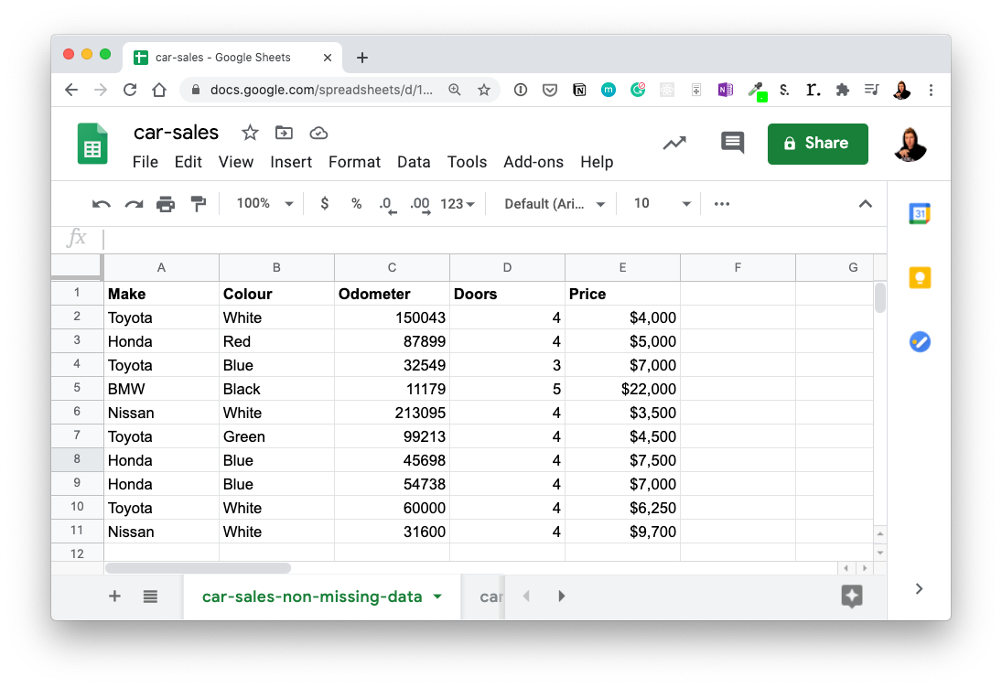
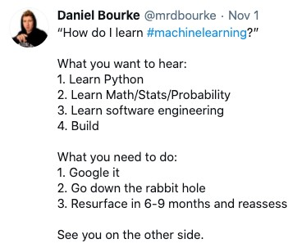




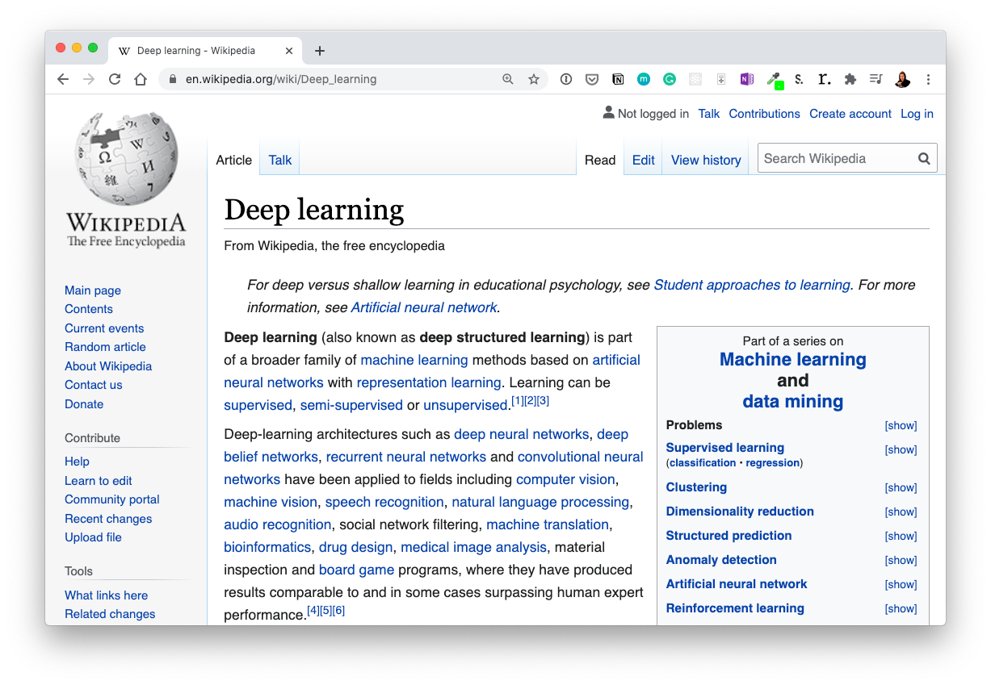


Machine Learning vs. Deep Learning
Machine Learning
Deep Learning
Structured data
Unstructured data

Slide 10
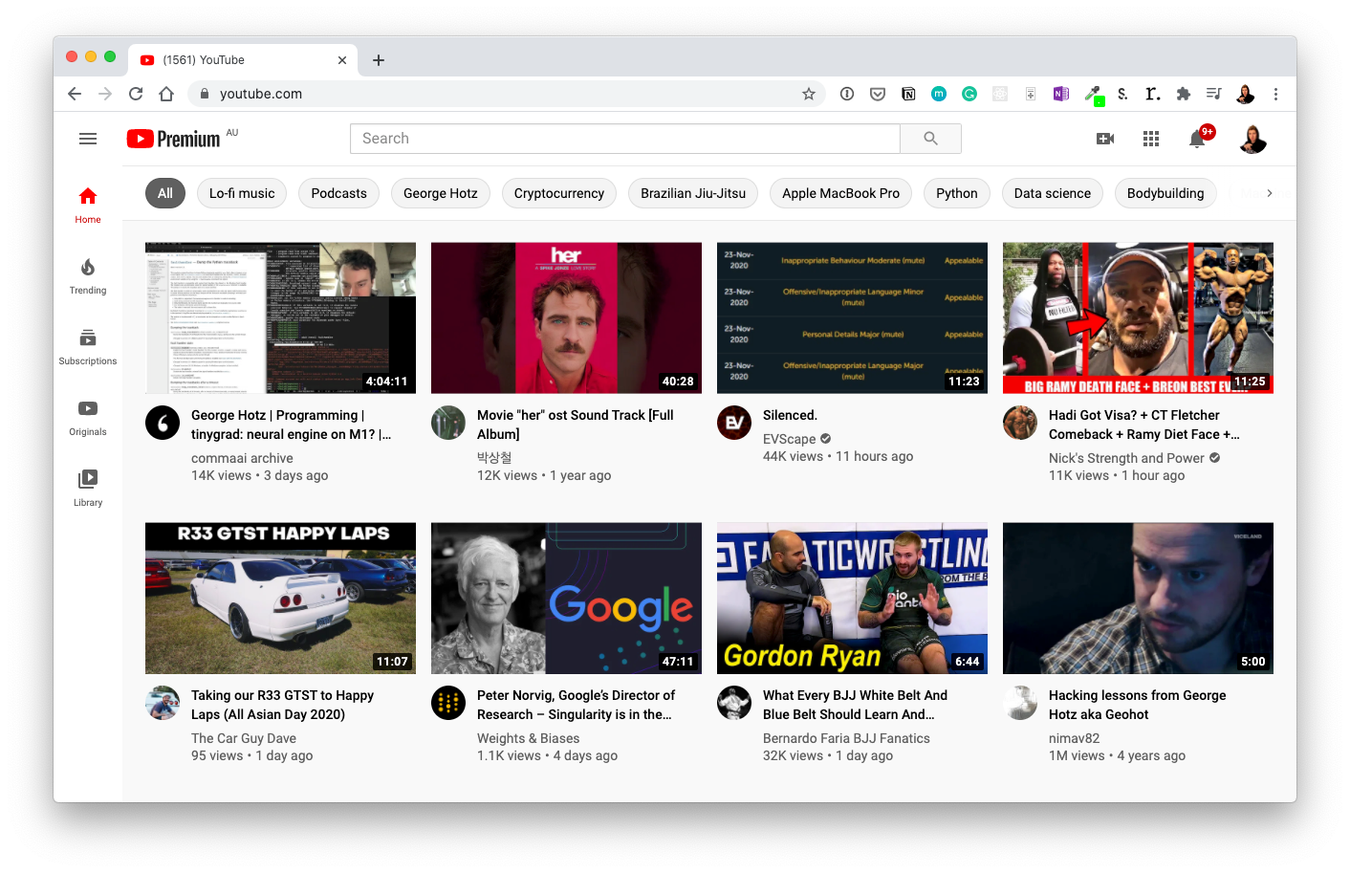
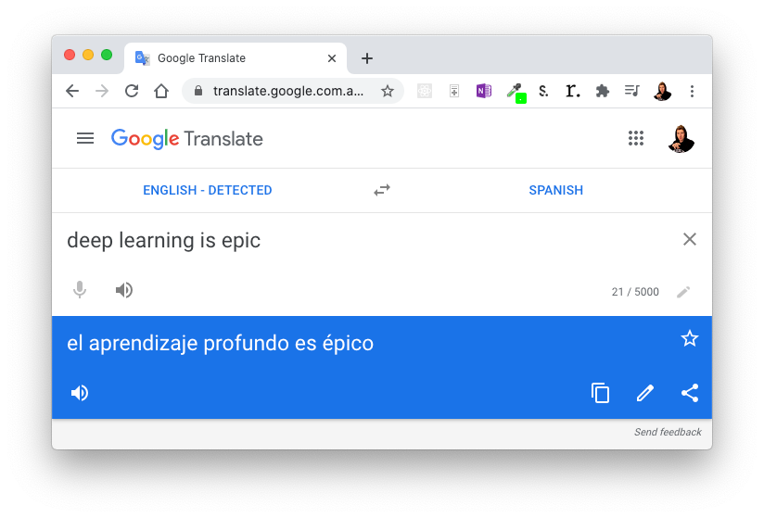
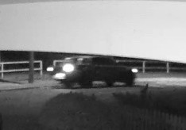
Deep Learning Use Cases
“Hey Siri, who’s the biggest big dog of them all?”
Speech recognition
Recommendation
Translation
To: daniel@mrdbourke.com Hey Daniel,
To: daniel@mrdbourke.com Hay daniel…
This deep learning course is incredible! I can’t wait to use what I’ve learned!
Not spam
C0ongratu1ations! U win $1139239230
Spam
Classfication /regression
Computer Vision
Natural Language Processing (NLP)

Slide 11


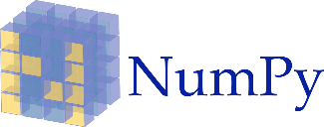
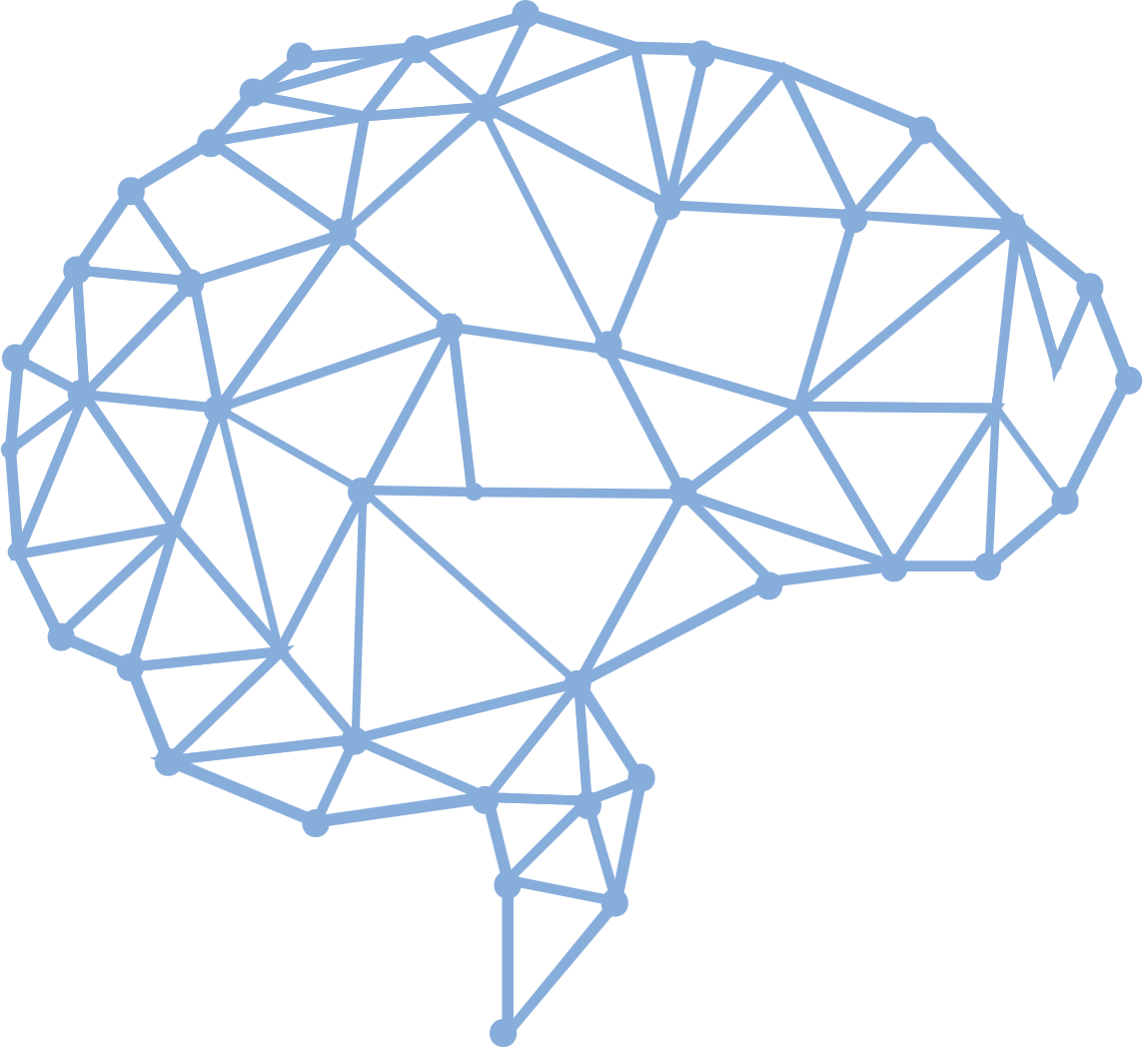




Deep Learning Libraries
Keras
Tensor Flow
Framework for Deep learning | Same code for CPU & GPU | Uses Theano/TF as Backend | CNN | not support multi GPU
Numerical computation using data flow graphs | Backend for Keras | Distributed computing on multiple GPU
Torch
Numerical Python & Scientific Python
Old ML & DL library | Supports CUDA - Compute Unified Device Architecture for parallel computation | Supervised image problem with CNN
Basic operation such as Sorting, Reshaping, indexing | Scientific computing | Most new feature belong in SciPy rather than Numpy
Caffe
Caffe is a deep learning framework made with expression, speed, and modularity in mind.Very high performance | Tuning Hyper parameters | CNN & RNN(Facebook extends) | | CPU & GPU
Mxnet
Apache MXNet is an open-source deep learning software framework, used to train, and deploy deep neural networks|More number of Language Bindings | Distributed computing

Slide 12
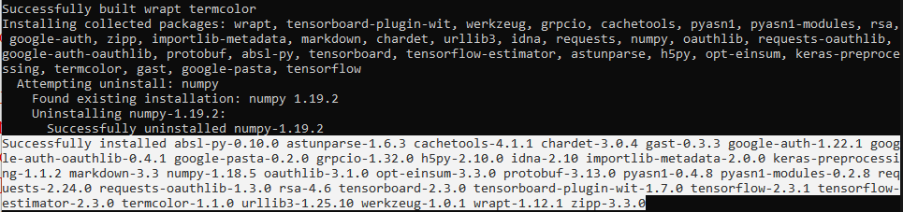
Installing Libraries
TensorFlow: pip install tensorflow

Slide 13
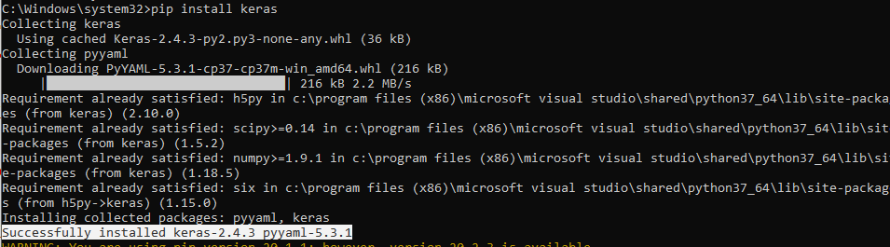
Installing Libraries
Keras: pip install keras

Slide 14
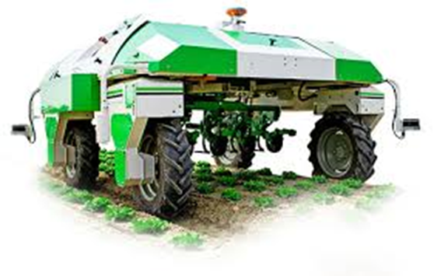
Applications of Deep Learning.
Fruit & vegetable classification
AI in Cooking
AI in Autonomous Vehicle
AI Doctor
Prediction of Disease from Medical Image
Voice recognition for ALS Patient

